Slide 1
How Finland’s Public Opinion Shifted Toward NATO (2020–2025)
Tracking changes in national security, defense, and public concerns through 6 years of sociological data
Project Objective:
Track the Change: Explore how public opinion in Finland transformed during the critical transition into NATO (from pre-war skepticism to post-accession unity).
Uncover Key Trends: Analyze real survey data to see how people's sense of security, defense confidence, and major societal concerns evolved over 6 years.
Oksana Kocherzhat
October 2026

Slide 2
The Source: Official annual surveys from the Finnish Social Science Data Archive (FSD) from 2020 to 2025 (Series FSD349, FSD3606, FSD3676, FSD3752, FSD3856, FSD3955, FSD4066).
Data Processing:
  Applied official respondent weights (PAINO) to accurately reflect Finland's population structure.
  Filtered out "Can't say" responses and missing values to calculate honest percentages and average scores.
Compliance: Fully adhered to FSD archive terms of use and data security standards.

Slide 3
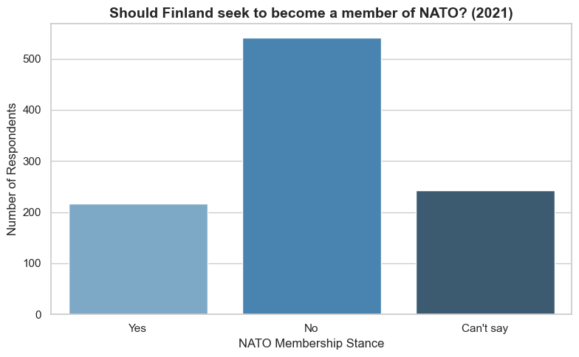
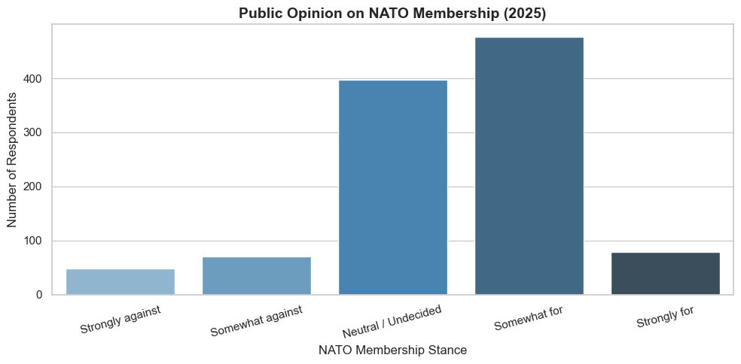
Evolution of Public Support for NATO (2021–2025)
Key Takeaways:
Before the War (2021): Before the events of 2022, most Finns were against joining NATO, and a large group was unsure ("Can't say").
After Joining NATO (2025): After the war started and Finland joined the alliance, public opinion completely flipped. By 2025, a strong majority of the population supported NATO membership.

Slide 4
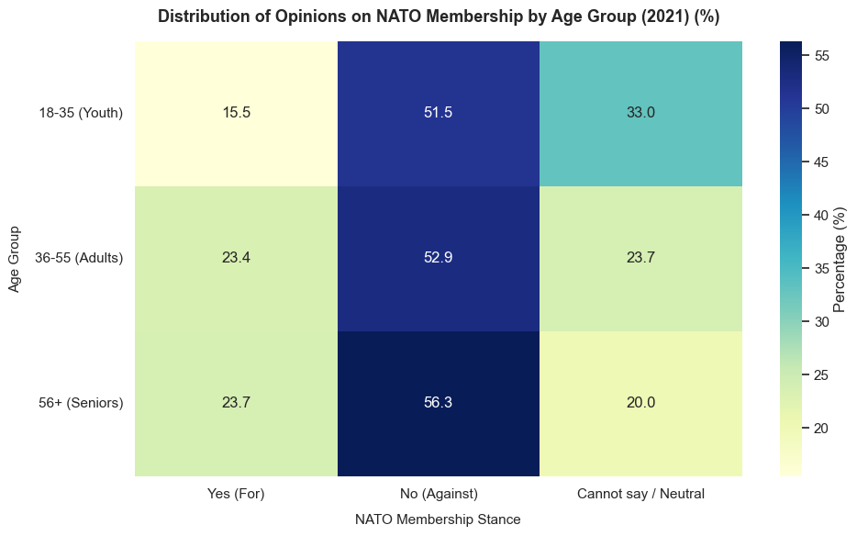
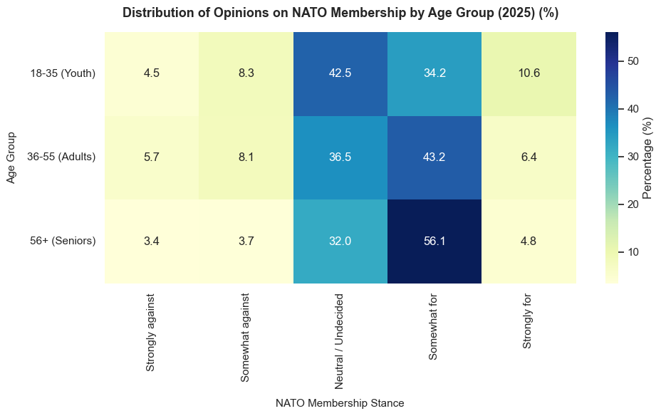
Generational Shifts: Age-Group Analysis
Key Takeaways:
Pattern in 2021: In 2021, the "No" response was dominant across all age groups (dark blue cells), while youth (18–35) showed a higher percentage of neutral or undecided answers ("Cannot say / Neutral" at 33.0%) compared to older cohorts.
Pattern in 2025: By 2025, the structure of opinions shifted significantly toward support. Seniors (56+) showed the strongest positive backing ("Somewhat for" at 56.1%), while younger and middle-aged groups formed solid majorities split across supportive categories.

Slide 5
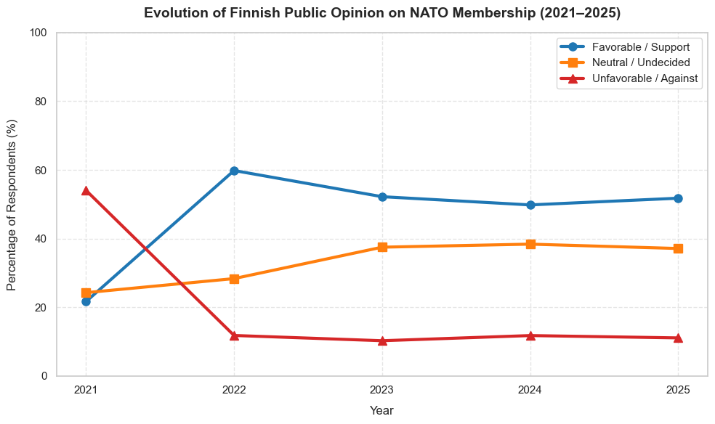
Evolution of Finnish Public Opinion on NATO Membership (2021–2025)
Key Takeaways:
Sharp Shift in 2022: In 2021, those against NATO (red line) significantly outnumbered supporters (blue line). However, in 2022, support surged dramatically while opposition dropped to minimal levels.
Long-Term Stability (2023–2025): From 2023 to 2025, public favorability stabilized above 50%, establishing a solid and lasting consensus following Finland's accession to the alliance.

Slide 6
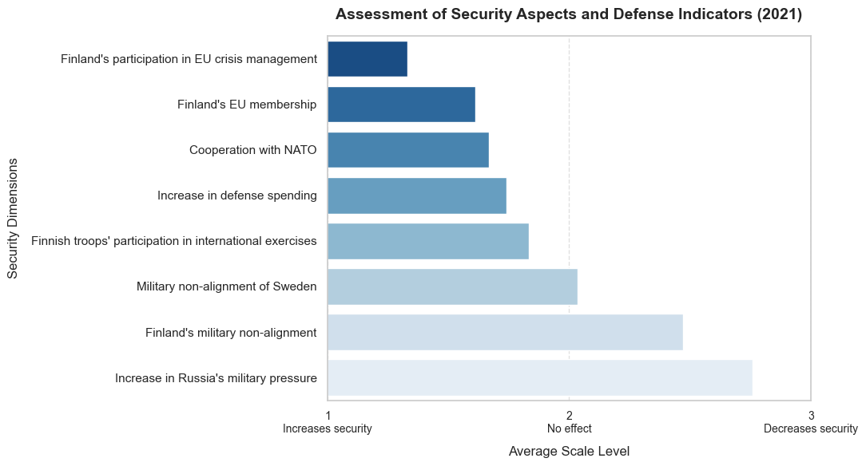
Assessment of Security Aspects and Defense (2021)
Before the shift (2021): Back then, staying militarily non-aligned and facing rising pressure from Russia made people very uneasy about national safety.
What helped: Joining forces internationally and working closely with the EU were seen as the main anchors of stability.

Slide 7
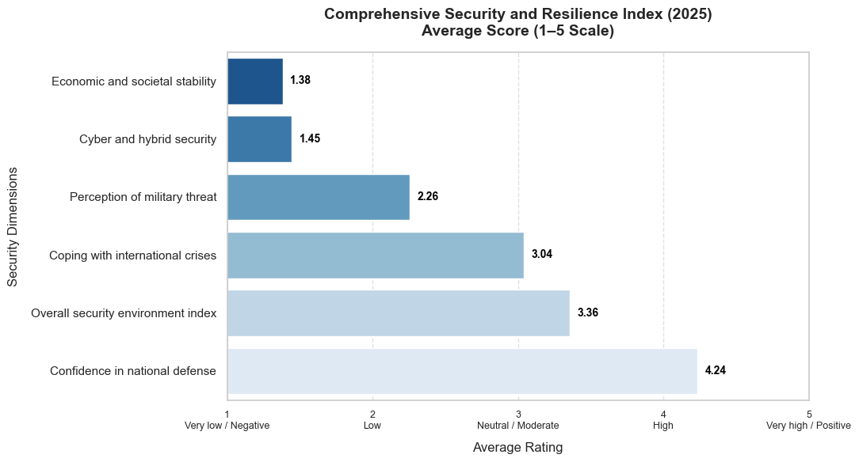
Comprehensive Security and Resilience Index (2025)
Defense Confidence (4.24/5): By 2025, people in Finland feel overwhelmingly confident in their national defense, giving it a score of over 4 out of 5.
Overall Resilience: Residents show strong confidence in handling international crises and keeping the country secure overall.

Slide 8
Tech Stack & Project Summary
Tech Stack:
  Python (Pandas, NumPy) for data processing and cleaning.
  Matplotlib and Seaborn for clear data visualization.
  FSD (Finnish Social Science Data Archive) survey processing workflow.
Key Takeaways:
  End-to-End Analysis: Cleaned and combined multi-year public survey data (2020–2025) into a smooth, reproducible workflow.
  Accurate Methodology: Applied official weighting (PAINO) and smart filtering to ensure the numbers accurately represent the public.
  Clear Story: The project clearly highlights how public opinion and societal resilience shifted during a major historical milestone.

